Slide 1
CS4100: Computer Architecture The Processor (III)
Prof. Chung-Ta King
Department of Computer Science
National Tsing Hua University, Taiwan

Slide 2
Outline
Problem statement and logic review (Sec. 4.1, 4.2)
Building a simple RISC-V processor with datapath and control (Sec. 4.3, 4.4)
Building a pipelined RISC-V processor with datapath and control (Sec. 4.5, 4.6)
Dealing hazards in pipelined processor: data and control hazards (Sec. 4.7, 4.8)
Handling exceptions (Sec. 4.9)
More advanced topics: parallelism via instructions, ARM Cortex-A53 and Intel Core i7 Pipelines, instruction-level parallelism (Sec. 4.10, 4.11, 4.12)

Slide 3
Pipeline Hazards
Situations that prevent starting the next instruction in the next cycle, e.g.,
add x19,x0,x1 sub x2,x19,x3
Note: Data flow between instructions through registers
Time
add x19,x0,x1
IM
Reg
ALU
DM
Reg
sub x2,x19,x3
IM
Reg
ALU
DM
Reg
sub would read old data

Slide 4
Three Types of Pipeline Hazards
Structure hazards
Conflict for use of a resource → need to wait for previous instruction to complete so to use the resource
Data hazard
Need to wait for previous instruction to complete its data read/write so to use the storage (registers/memory)
Control hazard
Need to wait for previous control-flow instruction to complete to decide whether to execution
Can always resolve hazards by waiting
Pipeline control must detect the hazard
Take action (or delay action) to resolve hazards

Slide 5
Structure Hazards
Suppose RISC-V pipeline has only a single memory
Load/store requires data access at its MEM stage
The third following instruction in IF also requires memory
Time
Mem
Reg
ALU
Mem
Reg
I
n
s
t
r.
O
r
d
e
r
ld
Instr 1
Mem
Reg
ALU
Mem
Reg
Instr 2
Mem
Reg
ALU
Mem
Reg
Instr 3
Mem
Reg
ALU
Mem
Reg
Instr 4
Mem
Reg
ALU
Mem
Reg
Both instructions access memory at same cycle

Slide 6
Structure Hazards
Suppose RISC-V pipeline has only a single memory
The third following instruction would have to stall for that cycle → cause a pipeline “bubble”
Solution: use two memory (data, instruction memory)
Or separate instruction/data caches
I-Mem
Reg
D-Mem
Reg
ALU

Slide 7
Data Hazards
An instruction depends on completion of data access to the same register by a previous instruction add x19, x0, x1 sub x2, x19, x3
Their overlapped execution in pipeline would cause the dependent instruction to fetch wrong data in registers
Time
add x19,x0,x1
IM
Reg
ALU
DM
Reg
sub x2,x19,x3
IM
Reg
DM
Reg
ALU

Slide 8
Dependences and Data Hazards
Data dependences between instructions may cause data hazards, depending on relative positions in pipe
RAW (read after write):
sub x2,x1,x3 and x6,x2,x5
WAR (write after read):
sub x6,x2,x5 and x2,x1,x3
WAW (write after write):
sub x2,x1,x3 and x2,x6,x5
i2 tries to read operand in the pipeline before i1 writes it → get old data instead of new
i2 tries to write operand in the pipeline before i1 reads it → get new data instead of old
i2 tries to write operand in the pipeline before i1 writes it → leave wrong data

Slide 9
Data Hazards in RISC-V 5-Stage Pipeline
WAR (write after read) and WAW (write after write) can’t happen in RISC-V 5-stage pipeline because:
All instructions take 5 stages
Reads are always in stage 2
Writes are always in stage 5
Thanks to the regularity in RISC-V ISA design
But, we still need to resolve RAW hazards
RAW hazards may occur between different stages

Slide 10
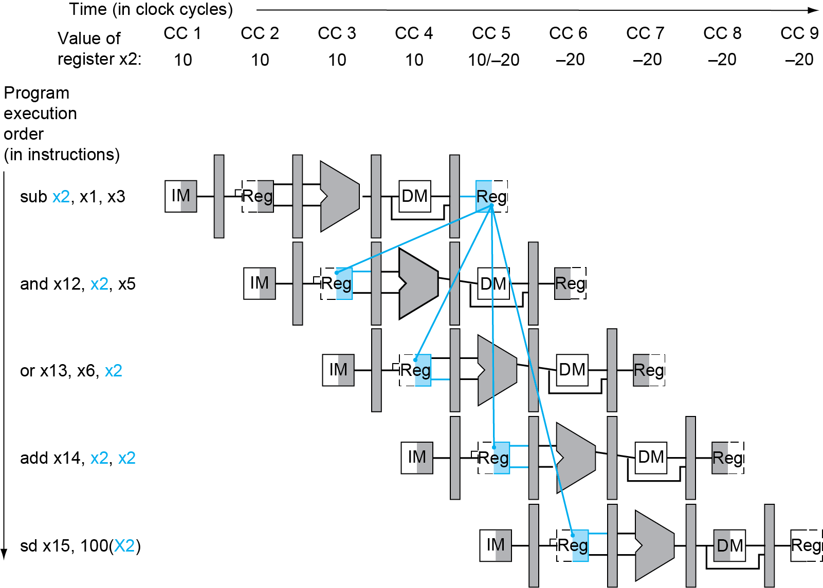
RAW Hazards among Different Stages
X2 = 10
sub x2,x1,x3 and x12,x2,x5 or x13,x6,x2 add x14,x2,x2 sw x15,100(x2)
X2 = -20
No hazard:
Write in 1st half cycle & read in 2nd half
Fig. 4.50

Slide 11
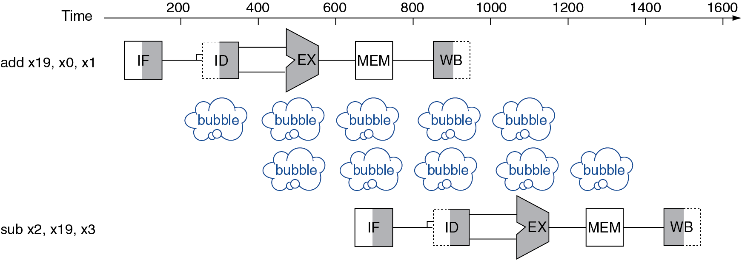
Resolving Data Hazards
Let dependent instruction wait until hazard is resolved, i.e., stall i2 until i1 writes back to register at the WB stage → insert pipeline bubbles
Better: forward data as soon as it is computed

Slide 12
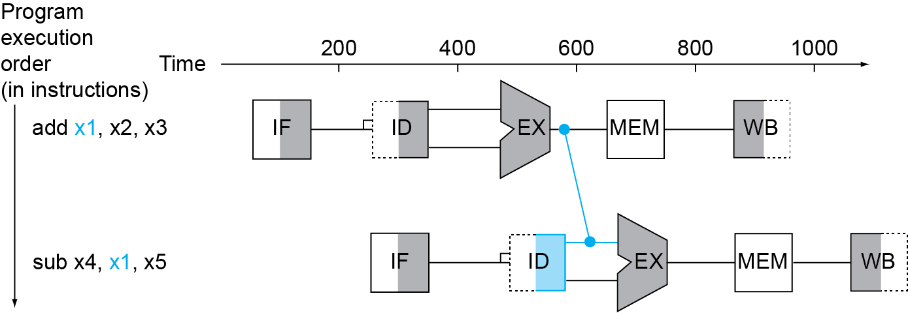
Forwarding (Bypassing)
Use result when it is computed, e.g., by ALU at the EX stage
Don’t wait for it to be stored in a register at WB stage
Requires extra connections in the datapath
X

Slide 13
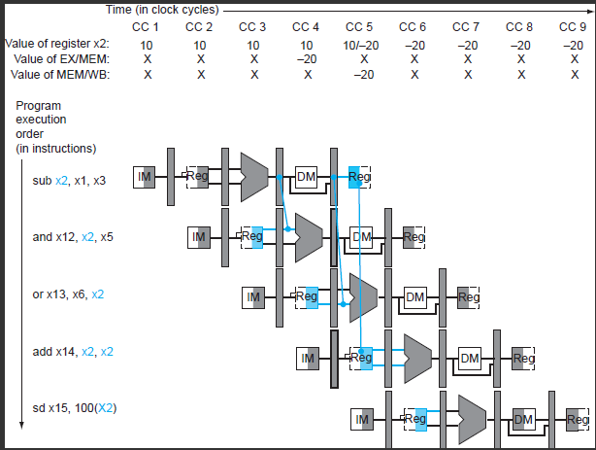
Forwarding between Stages
No hazard
Fig. 4.51

Slide 14
Detecting the Need to Forward
Pass register numbers along pipeline
e.g., ID/EX.RegisterRs1 = register number for Rs1 sitting in ID/EX pipeline register
ALU operand register numbers in EX stage given by
ID/EX.RegisterRs1, ID/EX.RegisterRs2
Data hazards when
1a. EX/MEM.RegisterRd = ID/EX.RegisterRs1 or
1b. EX/MEM.RegisterRd = ID/EX.RegisterRs2
Fwd from EX/MEM pipeline reg
Rd
Rs1
Rs2

Slide 15
Detecting the Need to Forward
Data hazards when (cont.)
2a. MEM/WB.RegisterRd = ID/EX.RegisterRs1
2b. MEM/WB.RegisterRd = ID/EX.RegisterRs2
Fwd from MEM/WB pipeline reg
Rd
Rs1
Rs2

Slide 16
Detecting the Need to Forward
But data hazard will occur only if the forwarding instruction will write to a register!
EX/MEM.RegWrite (for EX/MEM to ID/EX)
MEM/WB.RegWrite (for MEM/WB to ID/EX)
And only if Rd for that instruction is not x0
EX/MEM.RegisterRd ≠ 0 (for EX/MEM to ID/EX)
MEM/WB.RegisterRd ≠ 0 (for MEM/WB to ID/EX)

Slide 17
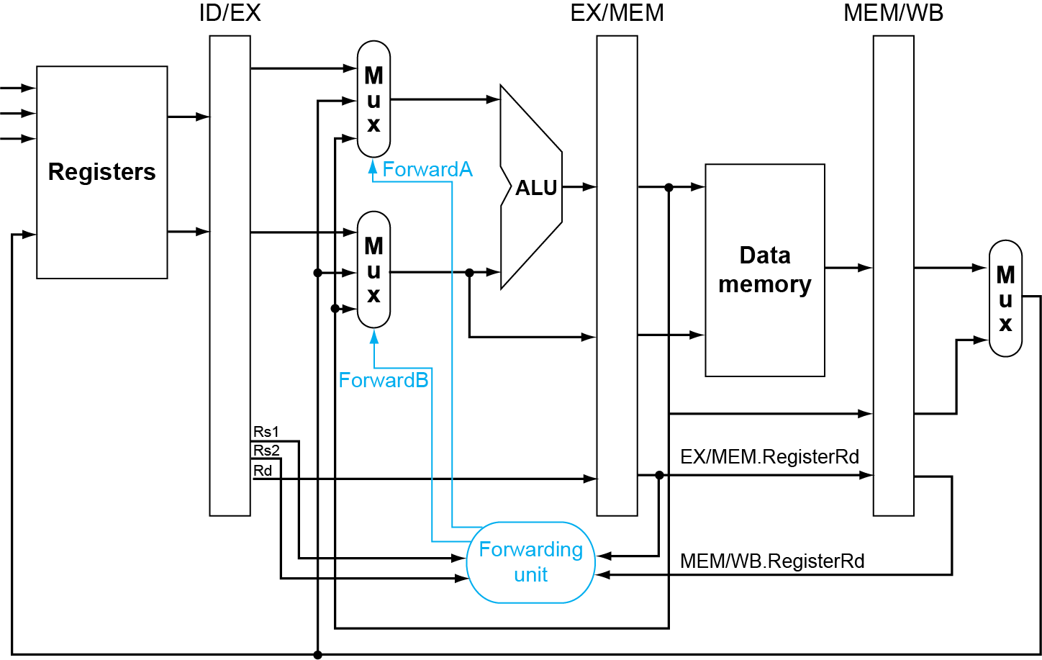
Forwarding Paths
EX hazard
Rd
Fig. 4.52

Slide 18
Forwarding Conditions
EX hazard
if (EX/MEM.RegWrite and (EX/MEM.RegisterRd ≠ 0) and (EX/MEM.RegisterRd = ID/EX.RegisterRs1)) ForwardA = 10
if (EX/MEM.RegWrite and (EX/MEM.RegisterRd ≠ 0) and (EX/MEM.RegisterRd = ID/EX.RegisterRs2)) ForwardB = 10

Slide 19
Forwarding Paths
MEM hazard
Rd
Fig. 4.52

Slide 20
Forwarding Conditions
MEM hazard
if (MEM/WB.RegWrite and (MEM/WB.RegisterRd ≠ 0) and (MEM/WB.RegisterRd = ID/EX.RegisterRs1)) ForwardA = 01
if (MEM/WB.RegWrite and (MEM/WB.RegisterRd ≠ 0) and (MEM/WB.RegisterRd = ID/EX.RegisterRs2)) ForwardB = 01
But there is a problem …

Slide 21
Double Data Hazards
Consider the sequence:
add x1,x1,x2 sub x1,x1,x3 and x1,x1,x4
Both hazards occur and both add and sub want to forward to and ➔ use the most recent, i.e., sub
Thus, need to revise MEM hazard condition
Forward only if EX hazard condition isn’t true

Slide 22
Revised Forwarding Condition
MEM hazard
if (MEM/WB.RegWrite and (MEM/WB.RegisterRd ≠ 0) and not (EX/MEM.RegWrite and (EX/MEM.RegisterRd ≠ 0) and (EX/MEM.RegisterRd = ID/EX.RegisterRs1)) and (MEM/WB.RegisterRd = ID/EX.RegisterRs1)) ForwardA = 01
if (MEM/WB.RegWrite and (MEM/WB.RegisterRd ≠ 0) and not (EX/MEM.RegWrite and (EX/MEM.RegisterRd ≠ 0) and (EX/MEM.RegisterRd = ID/EX.RegisterRs2)) and (MEM/WB.RegisterRd = ID/EX.RegisterRs2)) ForwardB = 01

Slide 23
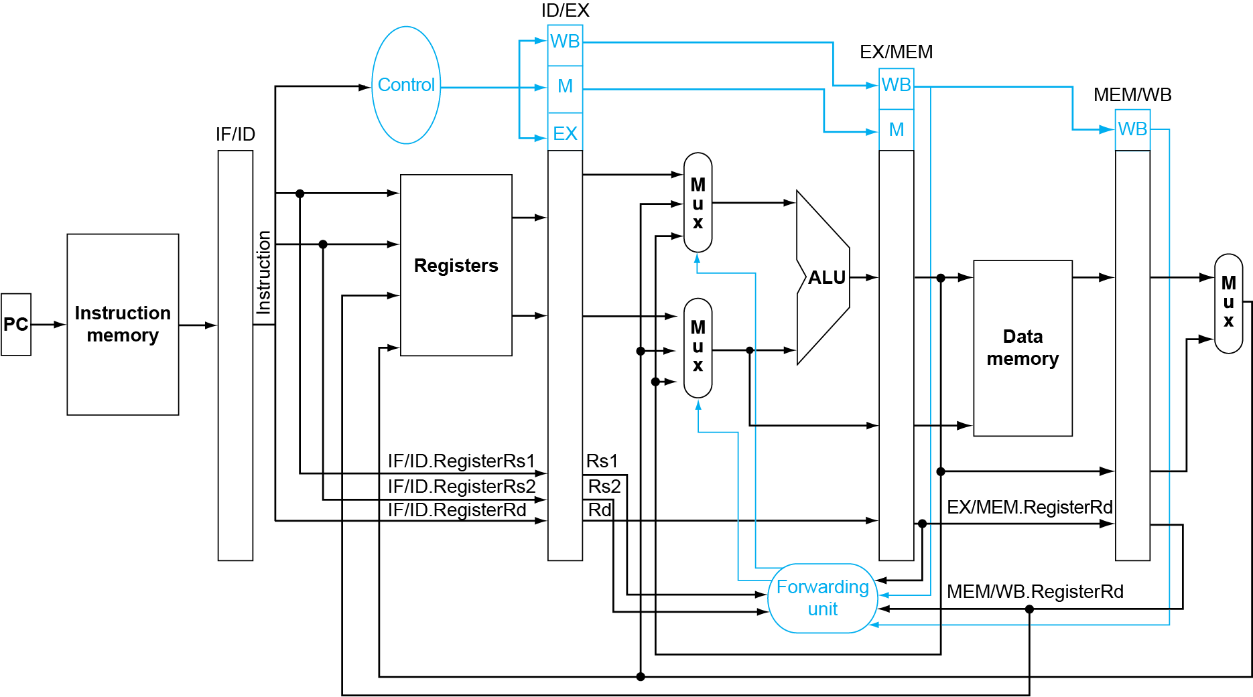
Datapath with Forwarding
Fig. 4.54

Slide 24
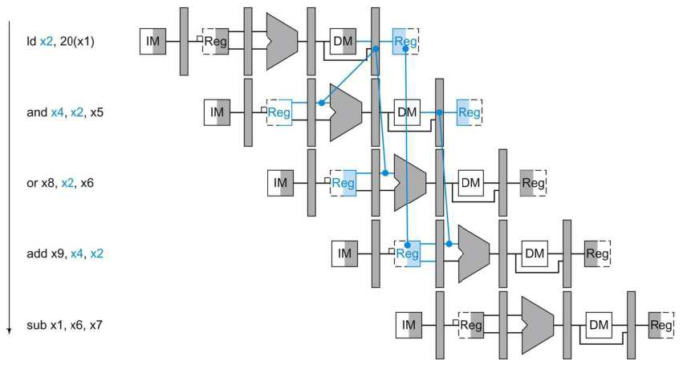
Can't Always Forward
ld can still cause a hazard: (load-use data hazard)
If it is followed by an instruction to read the loaded reg.
ld x2,20(x1)
and x4,x2,x5
Need to stall for one cycle
Fig. 4.56

Slide 25
Load-Use Hazard Detection
Check when the using instruction is decoded in the ID stage (lw is in the EX stage)
ALU operand register numbers in ID stage are given by
IF/ID.RegisterRs1, IF/ID.RegisterRs2
Load-use hazard when
ID/EX.MemRead and ((ID/EX.RegisterRd = IF/ID.RegisterRs1) or (ID/EX.RegisterRd = IF/ID.RegisterRs2))
Note that ID/EX.MemRead=1 indicates a load instruction
If detected, stall and insert bubble

Slide 26
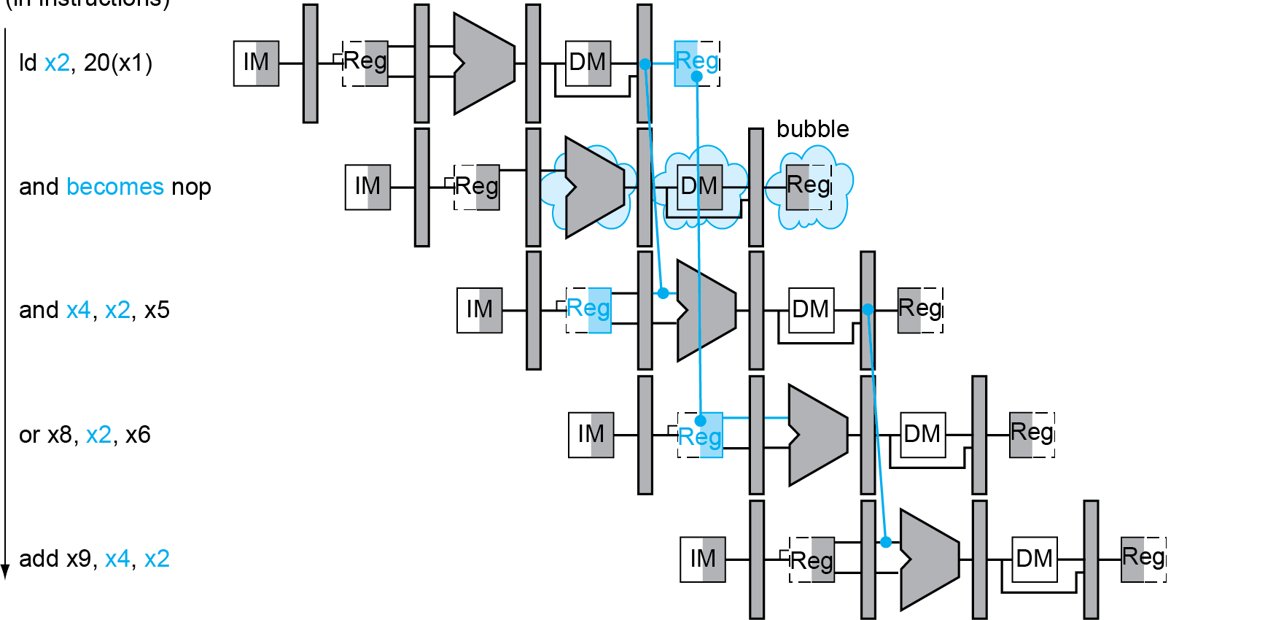
How to Stall an Instruction in the Pipeline?
Stall pipeline by keeping instructions in same stage and inserting an NOP instead
Stall inserted here
Fig. 4.57

Slide 27
How to Stall the Pipeline?
Stall instructions in IF and ID: Prevent update of PC and IF/ID register
The using instruction is decoded again
The following instruction is fetched again
1-cycle stall allows MEM to read data for ld
Can subsequently forward to EX stage
What to move into EX: Force control signals in ID/EX register to 0
Turn EX, MEM and WB into NOP (no-operation)
As control signals propagate, all control signals to EX, MEM, WB are deasserted, no registers or memories are written

Slide 28
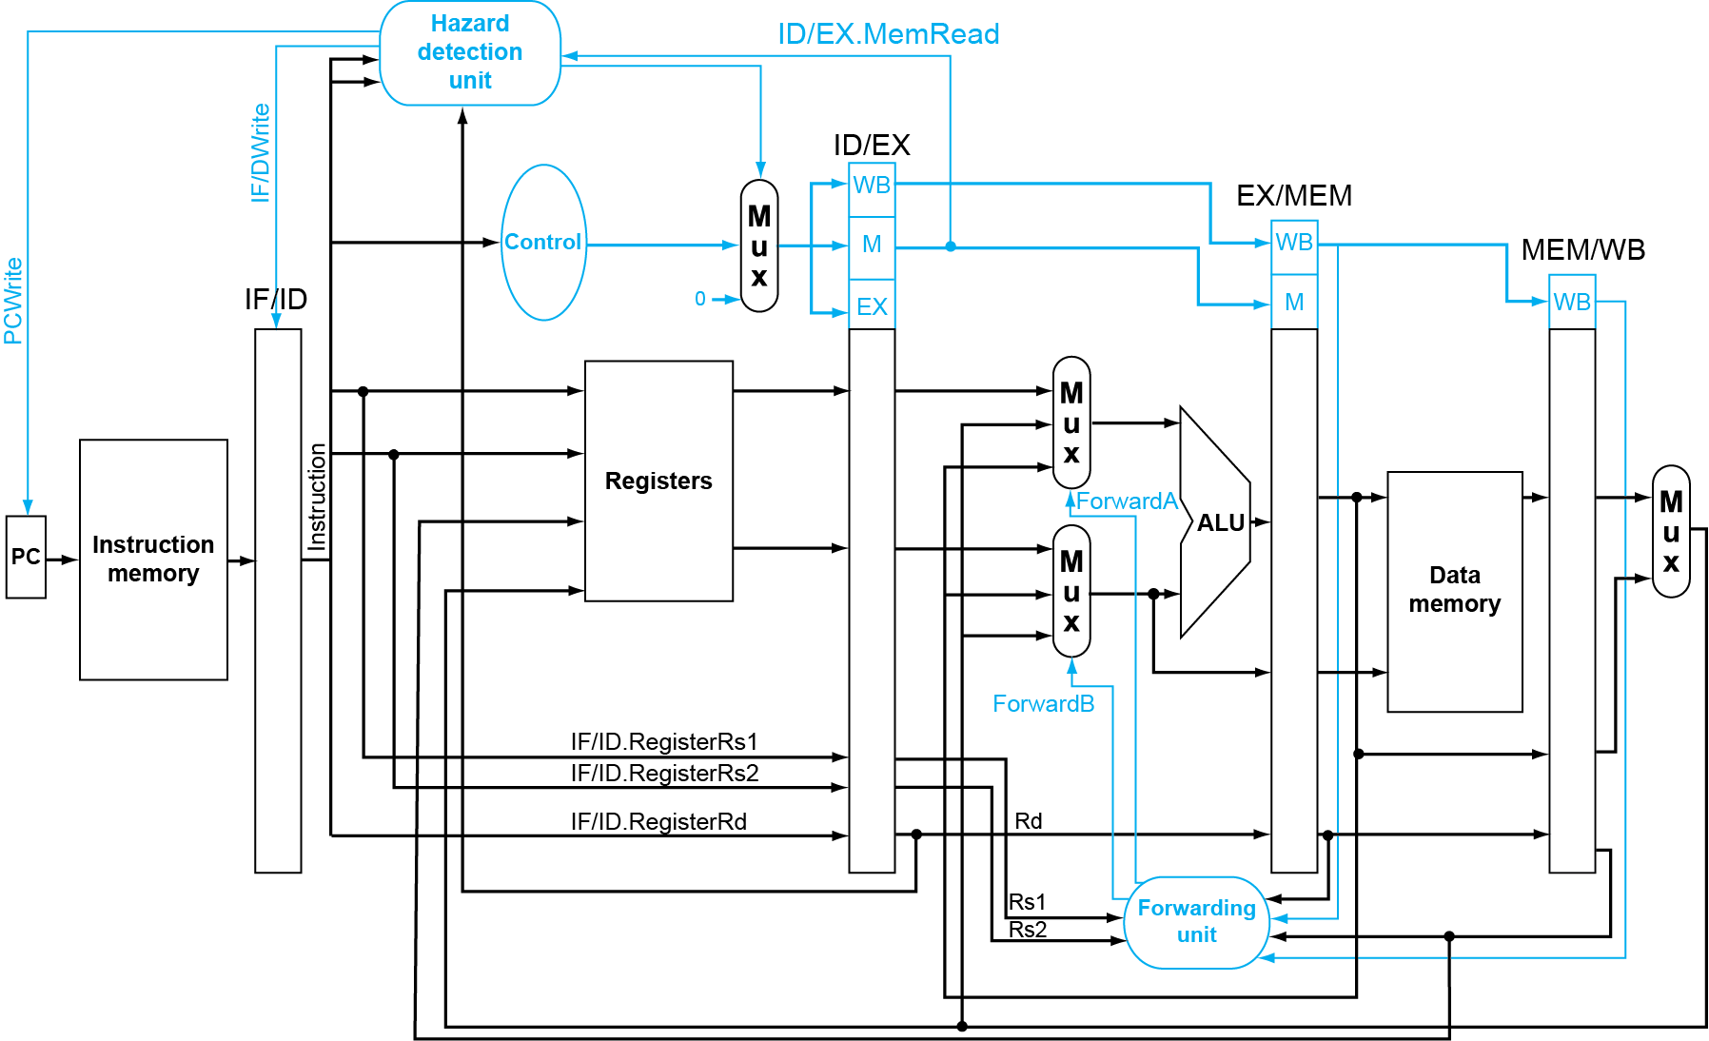
Datapath with Stalling Unit
ID/EX.MemRead and ((ID/EX.Rt = IF/ID.Rs1) or (ID/EX.Rt = IF/ID.Rs2))
Force control values in ID/EX to 0
Prevent update of PC & IF/ID
Fig. 4.58

Slide 29
Stalls and Performance
Stalls reduce performance
But are required to get correct results
Compiler can arrange code to avoid hazards and stalls
Requires knowledge of the pipeline structure
C code for A = B + E; C = B + F;
ld x1, 0(x0)
ld x2, 8(x0)
add x3, x1, x2
sd x3, 24(x0)
ld x4, 16(x0)
add x5, x1, x4
sd x5, 32(x0)
ld x1, 0(x0)
ld x2, 8(x0)
ld x4, 16(x0)
add x3, x1, x2
sd x3, 24(x0)
add x5, x1, x4
sd x5, 32(x0)
stall
stall
13 cycles
11 cycles

Slide 30
Control Hazards
Branch determines flow of control
Fetching next instruction depends on branch outcome
Pipeline can’t always fetch correct instruction
Still working on ID stage of branch
Need to wait until branch outcome determined before fetching next instruction
In RISC-V pipeline
Need to compare registers and compute target early in the pipeline
How early can we do it in the pipeline?

Slide 31
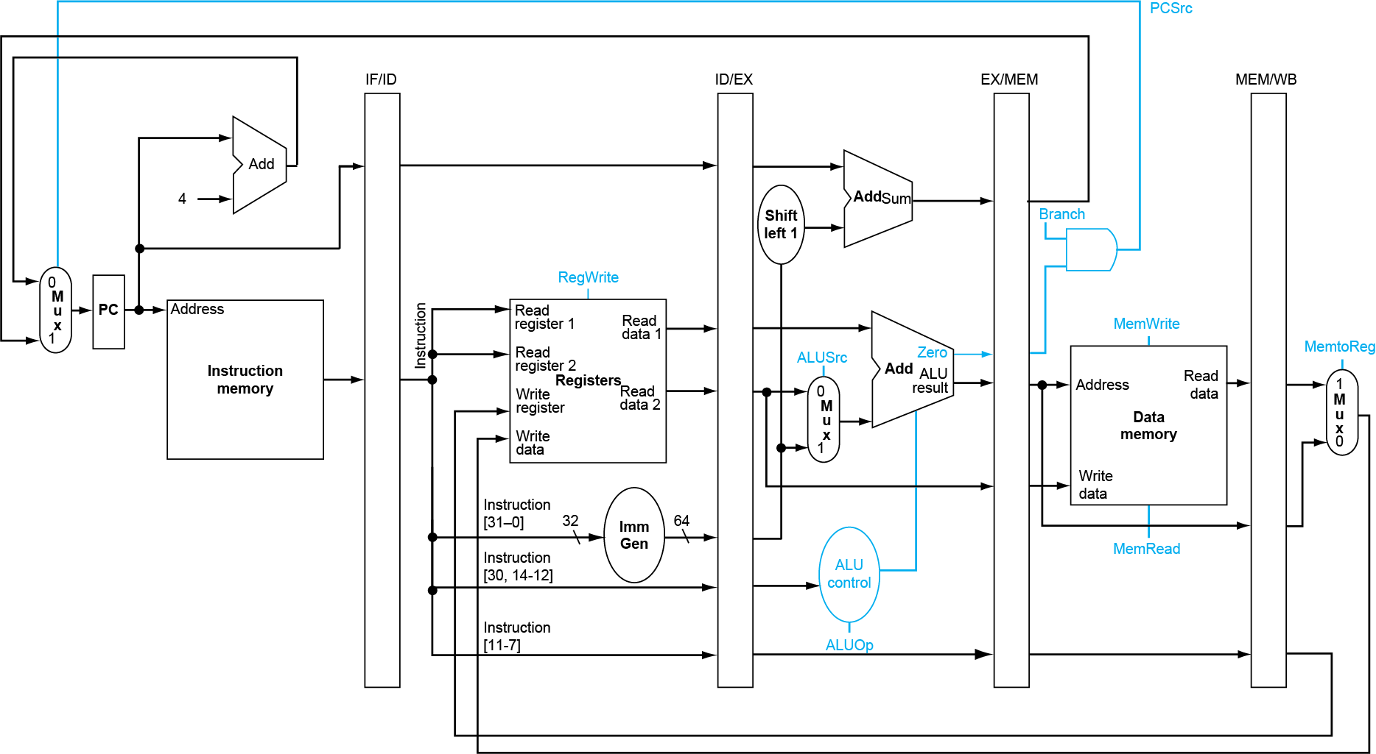
Control Hazards
beq determines whether to branch at the MEM stage
beq

Slide 32
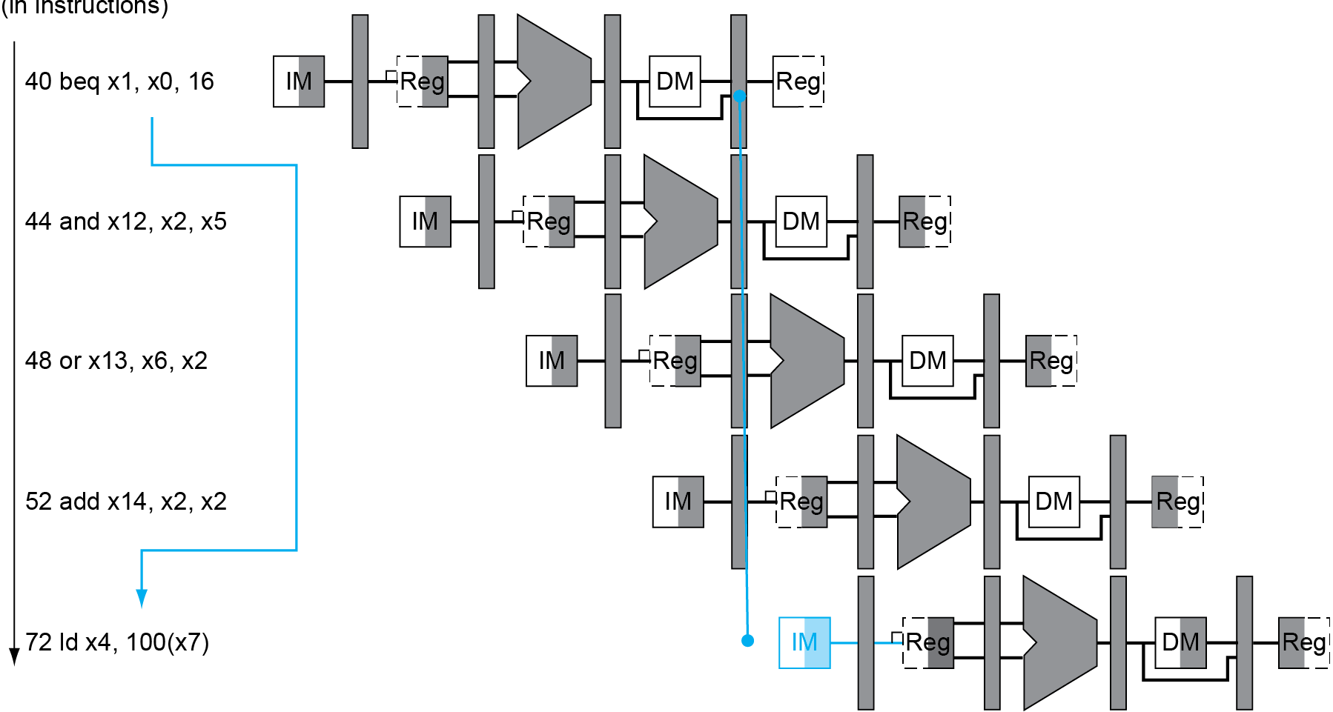
Control Hazards
When beq decides to branch, the following 3 instructions are already in pipeline!
Fig. 4.59
Flush these instructions
(Set control values to 0)
PC

Slide 33
Reducing Branch Delay
Add hardware to determine outcome at ID stage
Check branch equality at ID (using XOR)
Target address adder at ID stage
Will still fetch the next sequential instruction ➔ add a control signal, IF.Flush, to zero instruction field of IF/ID (making the following instruction an NOP)
Example: branch taken
36: sub x10, x4, x8 40: beq x1, x3, 16 // branch to 40+16*2=72 44: and x12, x2, x5 48: or x13, x2, x6 52: add x14, x4, x2 56: sub x15, x6, x7 ... 72: ld x4, 50(x7)

Slide 34
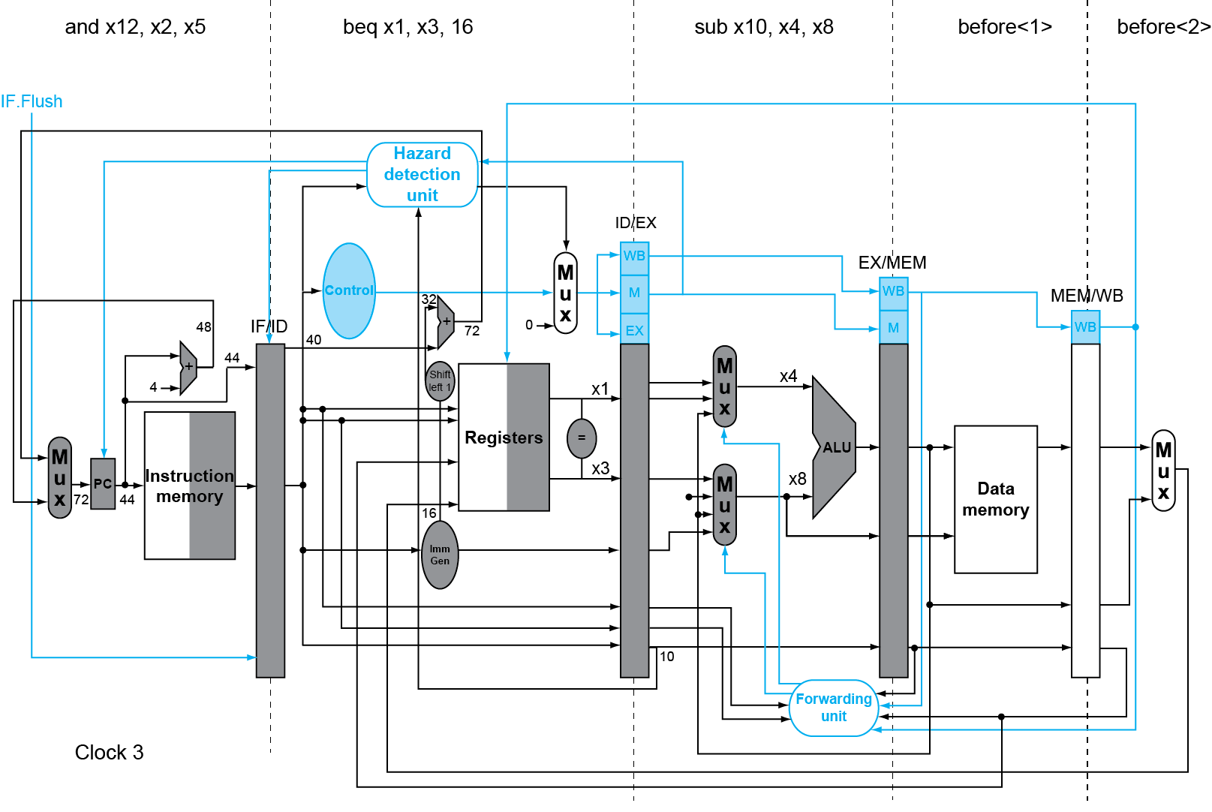
Example: Branch Taken
Fig. 4.60

Slide 35
Example: Branch Taken
Fig. 4.60

Slide 36
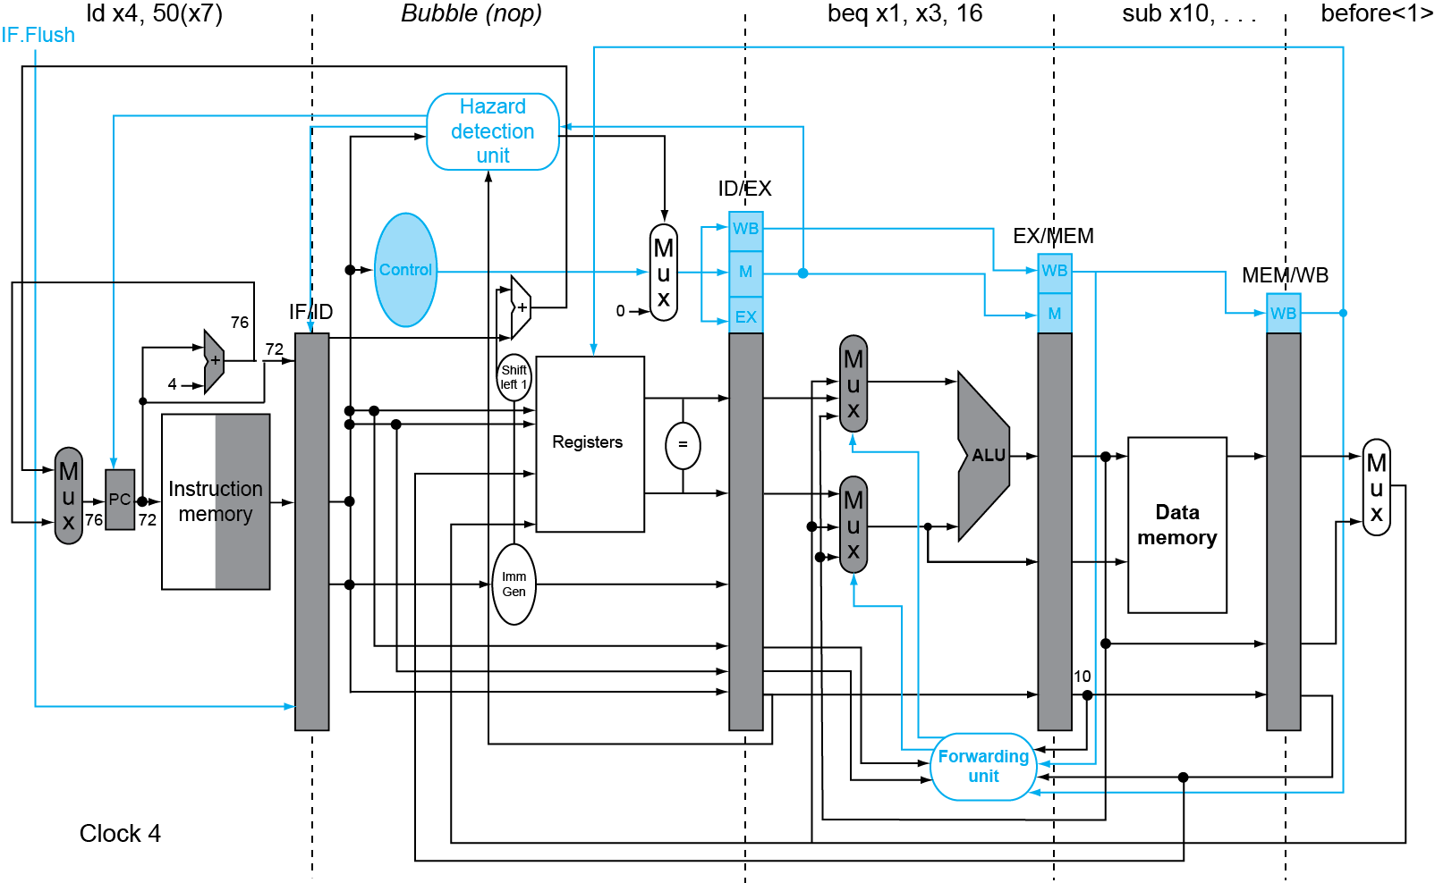
Example: Branch Taken
Fig. 4.60

Slide 37
Data Hazards for Branches
If a comparison register is a destination of 2nd or 3rd preceding ALU instruction
Can resolve using forwarding (how?)
Need to forward to ID stage in addition to EX stage!
add x1,x2,x3
IF
ID
EX
MEM
WB
add x4,x5,x6
IF
ID
EX
MEM
WB
…
IF
ID
EX
MEM
WB
beq x1,x4,target
IF
ID
EX
MEM
WB

Slide 38
Data Hazards for Branches
If a comparison register is a destination of preceding ALU instruction or 2nd preceding load instruction
Need 1 stall cycle
ld x1,addr
IF
ID
EX
MEM
WB
add x4,x5,x6
IF
ID
EX
MEM
WB
beq stalled
IF
ID
beq x1,x4,target
ID
EX
MEM
WB

Slide 39
Data Hazards for Branches
If a comparison register is a destination of immediately preceding load instruction
Need 2 stall cycles
How to check the conditions and stall pipeline stage?
ld x1,addr
IF
ID
EX
MEM
WB
beq stalled
IF
ID
beq stalled
ID
beq x1,x0,target
ID
EX
MEM
WB

Slide 40
Handling Control Hazards
Longer pipelines can’t readily determine branch outcome early
Stall penalty becomes unacceptable
Option 1: dynamic branch prediction
Predict outcome of branch
Only stall if prediction is wrong
Option 2: compiler rescheduling

Slide 41
Branch Prediction
Static branch prediction
Based on typical branch behavior
Example: loop and if-statement branches
Predict backward branches taken
Predict forward branches not taken
In RISC-V pipeline, can predict branches always not taken
Fetch instruction after branch, with no delay
Need to add hardware for flushing instructions if wrong
Dynamic branch prediction
Hardware measures actual branch behavior
e.g., record recent history of each branch
Assume future behavior will continue the trend
When wrong, stall while re-fetching, and update history

Slide 42
Dynamic Branch Prediction
Need to prediction two things:
Branch direction
Branch target
Branch direction:
Branch prediction buffer (branch history table), indexed by recent branch instruction addresses
Stores outcome (taken/not taken) in the table
To execute a branch
Check table, expect the same outcome
Start fetching from fall-through or target
If wrong, flush pipeline and flip prediction

Slide 43
Predicting Branch Direction
Predict branch based on past history of branch
Branch History Table (BHT)
PC
Hash
2^{N} entries
.
.
.
.
.
Table update
N bits
BHT: a cache of recent branches
Each entry stores last direction that the indexed branch went (1 bit to encode taken/not-taken)
No need to decode to know if it is a branch, just look at instr. address
FSM
Update
Logic
Actual outcome
Prediction
Notes:
Branch History Table (BHT)
Indexed by PC (or fraction of it)
Each entry stores last direction that the indexed branch went (1 bit to encode taken/not-taken)
Table is a cache of recent branches; non-branch instructions will have an entry of not-taken causing IF to fetch from sequential
Buffer size of 4096 entries are common (track 4K different branches)
When branch direction is resolved, go back into the table and update entry: 0 if not taken, 1 if taken

Slide 44
Problem with 1-Bit Predictor
Inner loop branches mispredicted twice!
Mispredict as taken on last iteration of inner loop
Then mispredict as not taken on first iteration of inner loop next time around
outer: … … inner: …
…
beq …, …, inner … beq …, …, outer

Slide 45
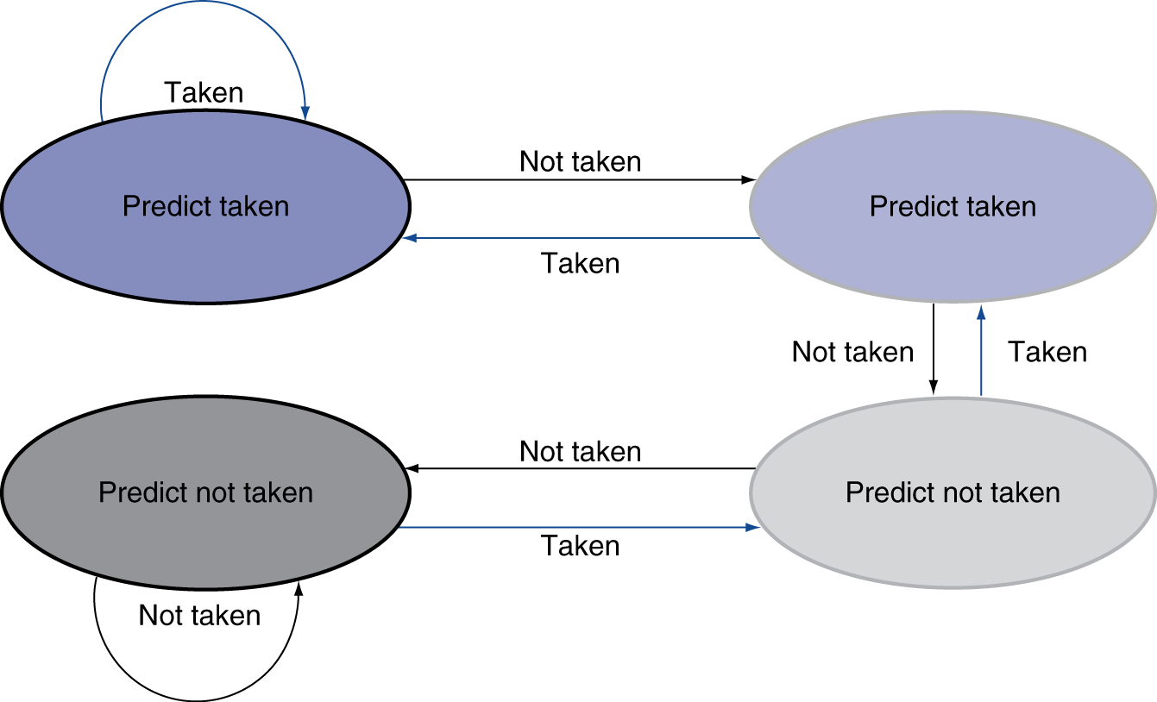
Solution: 2-Bit Predictor
Change prediction on two successive mispredictions
Fig. 4.61

Slide 46
Calculating the Branch Target
Need target address at same time as prediction
Branch Target Buffer (BTB): use PC to fetch instruction and simultaneously look up BTB to get prediction AND branch address (if taken)
Branch PC
Predicted PC
PC of instruction
Fetch
Yes: instruction is branch and use predicted PC as next PC
=?
Branch predicted
taken or untaken
No: branch not predicted, proceed normally

Slide 47
Outline
Problem statement and logic review (Sec. 4.1, 4.2)
Building a simple RISC-V processor with datapath and control (Sec. 4.3, 4.4)
Building a pipelined RISC-V processor with datapath and control (Sec. 4.5, 4.6)
Dealing hazards in pipelined processor: data and control hazards (Sec. 4.7, 4.8)
Handling exceptions (Sec. 4.9)
More advanced topics: parallelism via instructions, ARM Cortex-A53 and Intel Core i7 Pipelines, instruction-level parallelism (Sec. 4.10, 4.11, 4.12)

Slide 48
Events and Interrupts
What happen if CPU fetches an instruction and cannot understand its opcode?
What happen if you type a key on the keyboard? How does the computer know and start processing your input?
When these special “events” occur, the CPU needs to “interrupt” the currently executing program and switch to execute some special subroutines to handle the events

Slide 49
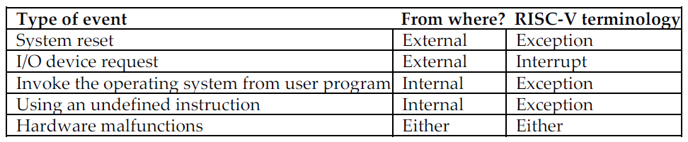
Exceptions and Interrupts
“Unexpected” events requiring change in flow of control to service the events
Similar to a procedure call, but unplanned
Exception
Arises within CPU, e.g., undefined opcode, overflow, syscall
Interrupt
From an external I/O controller

Slide 50
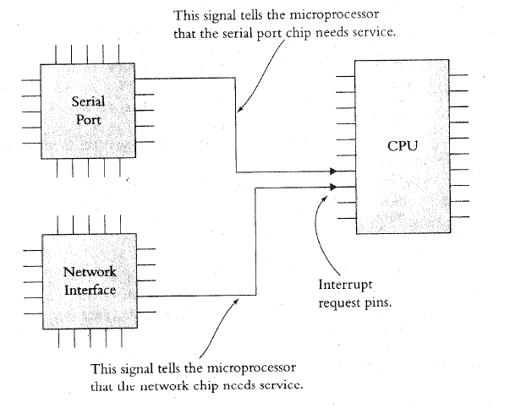
Detection of Exceptions and Interrupts
How does the CPU know when there is an interrupt?
Usually when it receives a signal from one of the IRQ (interrupt request) pins, which are connected to one or more external I/O controllers
How about exceptions?
CPU controller may raise a flag, e.g., undefined opcode, overflow, …

Slide 51
Handling External Interrupts
What does the CPU do in handling an interrupt?
When receiving an interrupt signal, the CPU (1) stops at the next instruction (2) saves the address of the next instruction somewhere (3) jumps to a specific interrupt service routine (ISR) or interrupt handler
ISR is basically a subroutine (stored at some specific location in memory) to perform operations to handle the interrupt with a RETURN at the end
How to be transparent to the running program?
Similar to handling a procedure call

Slide 52
Interrupt Service Routine
The following shows an example of an ISR
Task Code ISR
...
ld x3,100(x9)
or x1,x3,x4 sd x3,0(sp)
add x4,x2,x3 sd x4,-4(sp)
and x2,x3,x5 ...
beq x7,x9,END ;ISR code using x3,x4
sub x1,x3,x4 ...
... ld x4,-4(sp)
... ld x3,0(sp)
END: add x7,x8,x1 return
... ...
Save & restore (partial)
program state

Slide 53
Handling Internal Exceptions in RISC-V
Save PC of offending instruction
In RISC-V: Supervisor Exception Program Counter (SEPC)
Save indication of the problem
In RISC-V: Supervisor Exception Cause Register (SCAUSE)
64 bits, but most bits unused
Exception code field: 2 for undefined opcode, 12 for hardware malfunction, …
CPU controller will supply this based on exception
Jump to interrupt handler in OS to handle the exception based on the cause
Assume at 0000 0000 1C09 0000₁₆ (single entry point for all exceptions)

Slide 54
OS Handling Exceptions in RISC-V
Read cause, and transfer to relevant handler
Determine action required
If restartable
Take corrective action
Use SEPC to return to program
Otherwise
Terminate program
Report error using SEPC, SCAUSE, …

Slide 55
Alternate Way to Indicate Cause
Different handlers handle different causes/interrupts
Handler’s address in memory determined by the cause → vectored Interrupts
An exception vector address, supplied by the CPU controller based on interrupt source, to be added to a vector table base register to give handler address
Undefined opcode: 00 0100 0000₂
Hardware malfunction: 01 1000 0000₂
…: …
Instructions inside the handler either
Deal with the interrupt, or
Jump to the real handler
Exception vector address to be added to a Vector Table Base Register,

Slide 56
Exceptions in a RISC-V Pipeline
Treated as another form of control hazard
Consider malfunction on add in EX stage
add x1, x2, x3
Must prevent x1 from being clobbered
(1) Complete previous instructions
(2) Flush add and subsequent instructions, IF.Flush, ID.Flush, EX.Flush
(3) Set SEPC and SCAUSE register values
(4) Transfer control to handler at 0000 0000 1C09 0000₁₆
Similar to mispredicted branch
Use much of the same hardware

Slide 57
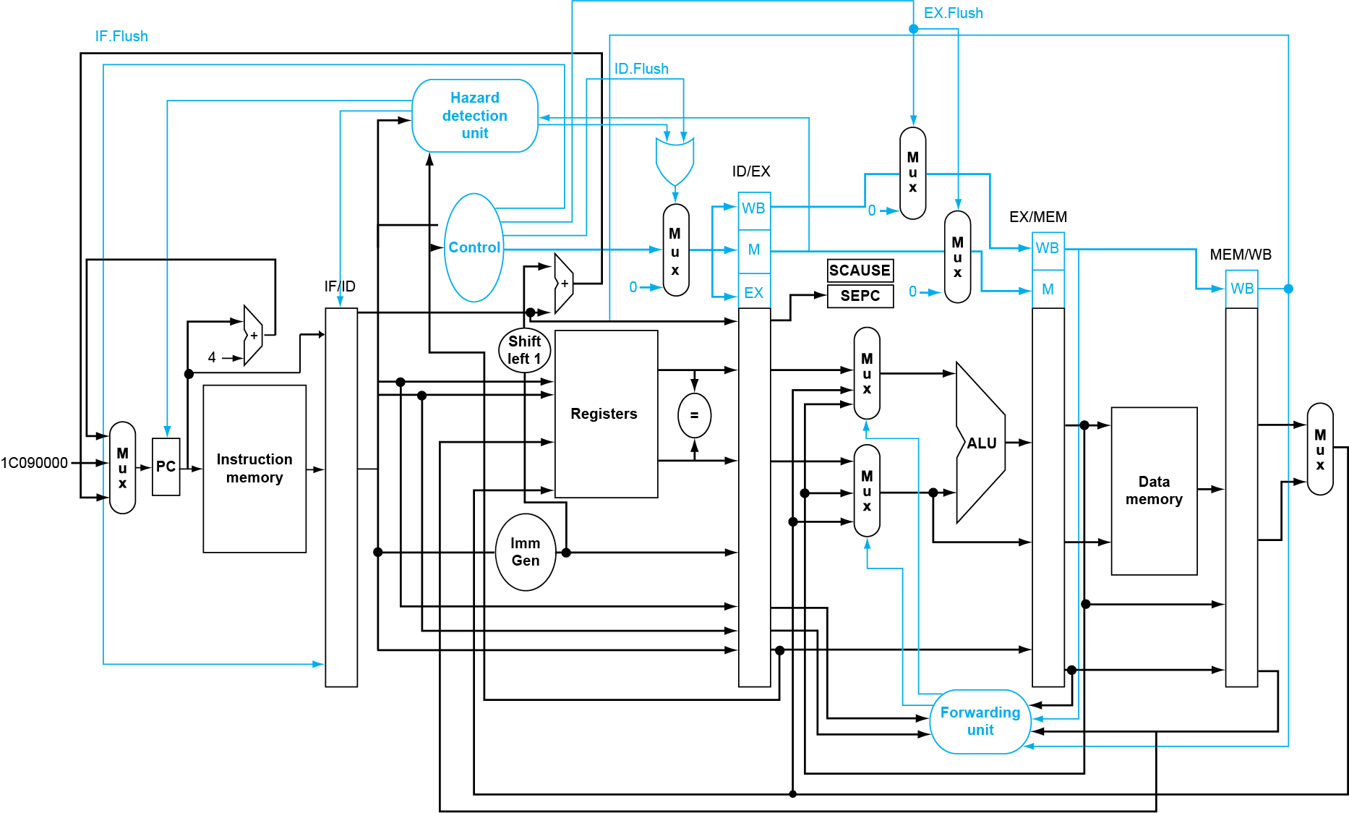
Pipeline with Exceptions
Fig. 4.63
Notes:
The ALU overflow signal is an input to the control unit.

Slide 58
Exception Handling
Restartable exceptions
Pipeline flushes the offending instruction and following instructions
Handler executes and then returns to the instruction
The instruction is refetched and executed from scratch
PC saved in SEPC register
Identifies the instruction causing the exception

Slide 59
Exception Example
Exception on add in
40 sub x11, x2, x4 44 and x12, x2, x5 48 or x13, x2, x6 4C add x1, x2, x1 50 sub x15, x6, x7 54 ld x16, 50(x7) …
Handler
1C090000 sd x26, 1000(x0) 1C090004 sd x27, 1008(x0) …

Slide 60
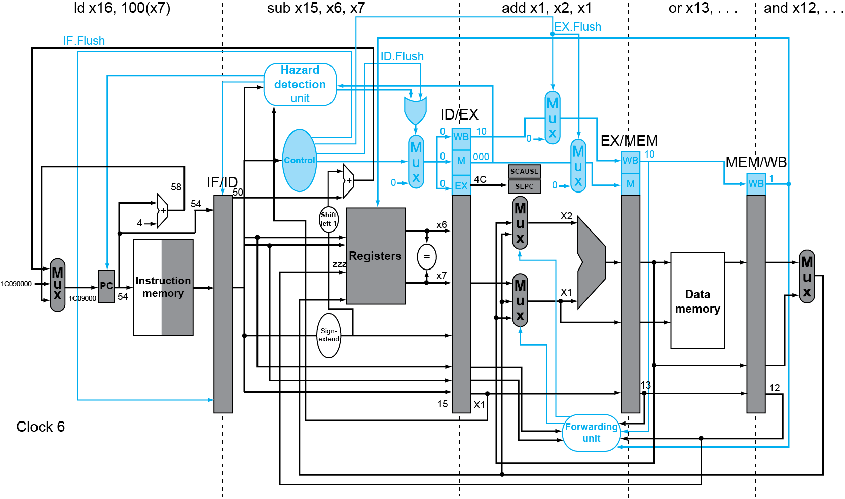
Exception Example
malfunction
Fig. 4.64

Slide 61
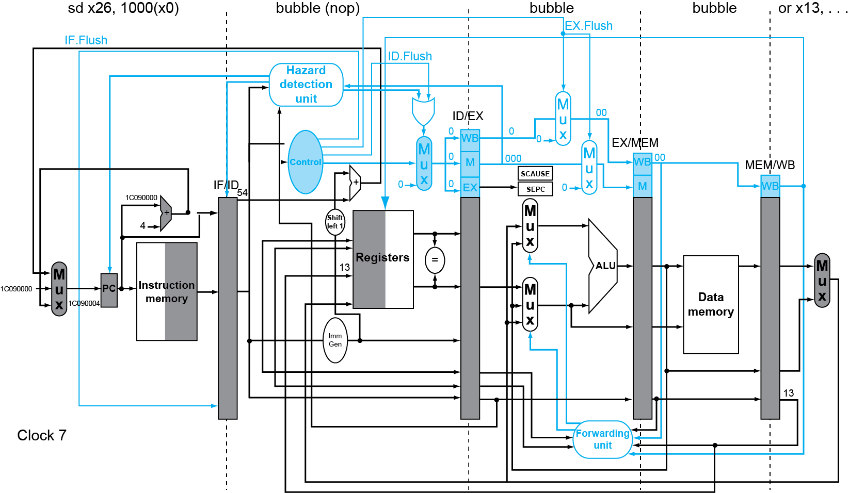
Exception Example
Fig. 4.64

Slide 62
Multiple Exceptions
Pipelining overlaps multiple instructions
Could have multiple exceptions at once
Simple approach:
Deal with exception from earliest instruction
Flush subsequent instructions → “precise” exceptions
Good to know in which pipeline stage a type of exception can occur
In complex pipelines
Multiple instructions per cycle, out-of-order completion
Maintaining precise exceptions is difficult!
Some computers provide imprecise exceptions
Simplifies hardware, but more complex handler software
Notes:
Just stop pipeline and save state
Including exception cause(s)
Let the handler work out
Which instruction(s) had exceptions
Which to complete or flush
May require “manual” completion

Slide 63
Pipeline Summary
Pipelining improves performance by increasing instruction throughput
Executes multiple instructions in parallel
Each instruction has the same latency
Subject to hazards
Structure, data, control
Handling hazards by forwarding, stalling, compiler scheduling
Must handle exceptions properly
Instruction set design affects complexity of pipeline implementation

Slide 64
Backup Slides

Slide 65
Outline
Problem statement and logic review (Sec. 4.1, 4.2)
Building a simple RISC-V processor with datapath and control (Sec. 4.3, 4.4)
Building a pipelined RISC-V processor with datapath and control (Sec. 4.5, 4.6)
Dealing hazards in pipelined processor: data and control hazards (Sec. 4.7, 4.8)
Handling exceptions (Sec. 4.9)
More advanced topics: parallelism via instructions, ARM Cortex-A53 and Intel Core i7 Pipelines, instruction-level parallelism (Sec. 4.10, 4.11, 4.12)

Slide 66
Instruction-Level Parallelism (ILP)
Pipelining: execute multiple instructions in parallel
To increase ILP:
Deeper pipeline ⇒ less work per stage, shorter clock cycle
Still one cycle per instruction
Multiple-issue
Replicate pipeline stages ⇒ multiple pipelines
Fetch and start multiple instructions per clock cycle
CPI < 1, e.g., 4GHz 4-way multiple-issue → 16 BIPS, peak CPI = 0.25, peak IPC = 4 (Instructions Per Cycle) → dependencies among instructions reduce this in practice

Slide 67
Multiple Issue
Static multiple issue
Compiler detects and avoids hazards, and groups parallel instructions to be issued together
Packages them into “issue slots” → very long instruction word (VLIW)
CPU does not need to check hazards
Dynamic multiple issue
CPU examines instruction stream and chooses instructions to issue in each cycle (limited by instruction fetch window)
Compiler can help by reordering instructions so that CPU may find more parallel instructions
CPU resolves hazards using advanced techniques at runtime

Slide 68
Speculation
“Guess” what to do with an instruction
Start operation as soon as possible
Check whether guess was right
If so, complete the operation
If not, roll-back and do the right thing
Common to static and dynamic multiple issue
Examples
Speculate on branch outcome
Roll back if path taken is different
Speculate on load
Roll back if location is updated

Slide 69
Compiler/Hardware Speculation
Compiler can reorder instructions
e.g., move load before branch
Can include “fix-up” instructions to recover from incorrect guess
Hardware can look ahead for instructions to execute
Buffer results until it determines they are actually needed
Flush buffers on incorrect speculation

Slide 70
Speculation and Exceptions
What if exception occurs on a speculatively executed instruction?
e.g., speculative load before null-pointer check
Static speculation
Can add ISA support for deferring exceptions
Dynamic speculation
Can buffer exceptions until instruction completion (which may not occur)

Slide 71
Static Multiple Issue
Compiler groups instructions into “issue packets”
Group of instructions that can be issued on a single cycle
Determined by pipeline resources required
Think of an issue packet as a very long instruction
Specifies multiple concurrent operations
⇒ Very Long Instruction Word (VLIW)

Slide 72
Scheduling Static Multiple Issue
Compiler must remove some/all hazards
Reorder instructions into issue packets
No dependencies with a packet
Possibly some dependencies between packets
Varies between ISAs; compiler must know!
Pad with nop if necessary

Slide 73
RISC-V with Static Dual Issue
Two-issue packets
One ALU/branch instruction
One load/store instruction
64-bit aligned
ALU/branch, then load/store
Pad an unused instruction with nop
Address | Instruction type | Pipeline Stages
n | ALU/branch | IF | ID | EX | MEM | WB
n + 4 | Load/store | IF | ID | EX | MEM | WB
n + 8 | ALU/branch |  | IF | ID | EX | MEM | WB
n + 12 | Load/store |  | IF | ID | EX | MEM | WB
n + 16 | ALU/branch |  |  | IF | ID | EX | MEM | WB
n + 20 | Load/store |  |  | IF | ID | EX | MEM | WB

Slide 74
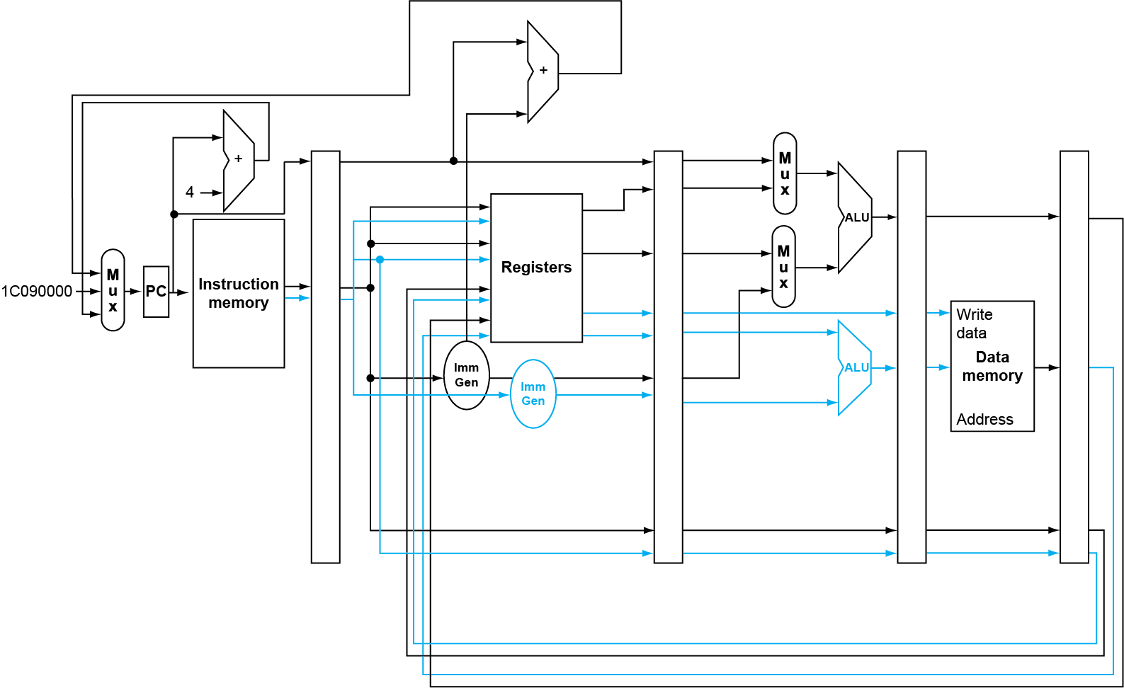
RISC-V with Static Dual Issue

Slide 75
Hazards in the Dual-Issue RISC-V
More instructions executing in parallel
EX data hazard
Forwarding avoided stalls with single-issue
Now can’t use ALU result in load/store in same packet
add x10, x0, x1 ld x2, 0(x10)
Split into two packets, effectively a stall
Load-use hazard
Still one cycle use latency, but now two instructions
More aggressive scheduling required

Slide 76
Scheduling Example
Schedule this for dual-issue RISC-V
IPC = 5/4 = 1.25 (c.f. peak IPC = 2)
Loop: ld x31,0(x20) // x31=array element add x31,x31,x21 // add scalar in x21 sd x31,0(x20) // store result addi x20,x20,-8 // decrement pointer blt x22,x20,Loop // branch if x22 < x20
 | ALU/branch | Load/store | cycle
Loop: | nop | ld x31,0(x20) | 1
 | addi x20,x20,-8 | nop | 2
 | add x31,x31,x21 | nop | 3
 | blt x22,x20,Loop | sd x31,8(x20) | 4

Slide 77
Loop Unrolling
Replicate loop body to expose more parallelism
Reduces loop-control overhead
Use different registers per replication
Called “register renaming”
Avoid loop-carried “anti-dependencies”
Store followed by a load of the same register
Aka “name dependence”: reuse of a register name

Slide 78
Loop Unrolling Example
 | ALU/branch | Load/store | cycle
Loop: | addi x20,x20,-32 | ld x28, 0(x20) | 1
 | nop | ld x29, 24(x20) | 2
 | add x28,x28,x21 | ld x30, 16(x20) | 3
 | add x29,x29,x21 | ld x31, 8(x20) | 4
 | add x30,x30,x21 | sd x28, 32(x20) | 5
 | add x31,x31,x21 | sd x29, 24(x20) | 6
 | nop | sd x30, 16(x20) | 7
 | blt x22,x20,Loop | sd x31, 8(x20) | 8
IPC = 14/8 = 1.75
Closer to 2, but at cost of registers and code size

Slide 79
Dynamic Multiple Issue
“Superscalar” processors
CPU decides whether to issue 0, 1, 2, … each cycle
Avoiding structural and data hazards
Avoids the need for compiler scheduling
Though it may still help
Code semantics ensured by the CPU

Slide 80
Dynamic Pipeline Scheduling
Allow the CPU to execute instructions out of order to avoid stalls
But commit result to registers in order
Example
ld x31,20(x21) add x1,x31,x2 sub x23,x23,x3 andi x5,x23,20
Can start sub while add is waiting for ld

Slide 81
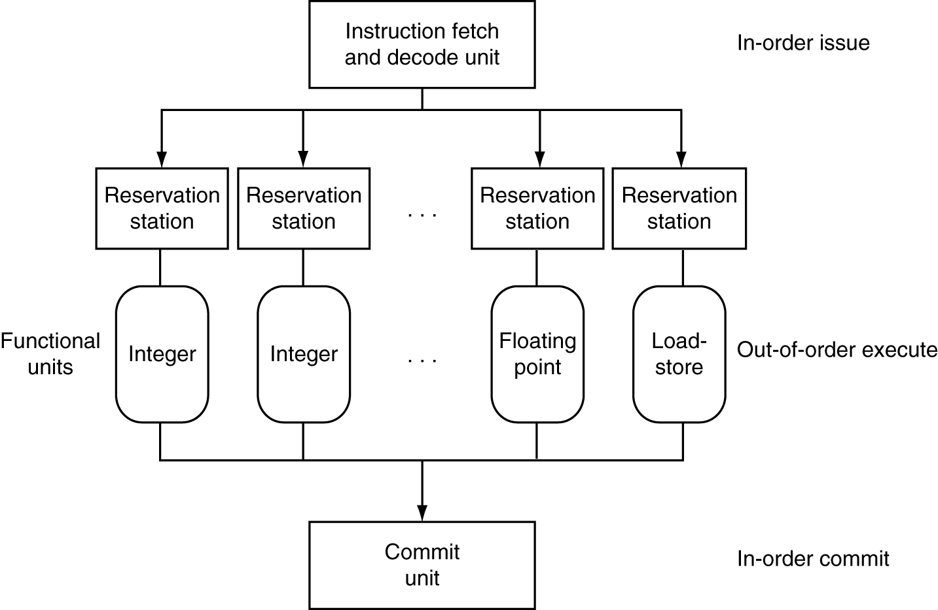
Dynamically Scheduled CPU
Preserves dependencies
Hold pending operands
Results also sent to any waiting reservation stations
Reorders buffer for register writes
Can supply operands for issued instructions

Slide 82
Register Renaming
Reservation stations and reorder buffer effectively provide register renaming
On instruction issue to reservation station
If operand is available in register file or reorder buffer
Copied to reservation station
No longer required in the register; can be overwritten
If operand is not yet available
It will be provided to the reservation station by a function unit
Register update may not be required

Slide 83
Speculation
Predict branch and continue issuing
Don’t commit until branch outcome determined
Load speculation
Avoid load and cache miss delay
Predict the effective address
Predict loaded value
Load before completing outstanding stores
Bypass stored values to load unit
Don’t commit load until speculation cleared

Slide 84
Why Do Dynamic Scheduling?
Why not just let the compiler schedule code?
Not all stalls are predicable
e.g., cache misses
Can’t always schedule around branches
Branch outcome is dynamically determined
Different implementations of an ISA have different latencies and hazards

Slide 85
Does Multiple Issue Work?
Yes, but not as much as we’d like
Programs have real dependencies that limit ILP
Some dependencies are hard to eliminate
e.g., pointer aliasing
Some parallelism is hard to expose
Limited window size during instruction issue
Memory delays and limited bandwidth
Hard to keep pipelines full
Speculation can help if done well

Slide 86
Power Efficiency
Complexity of dynamic scheduling and speculations requires power
Multiple simpler cores may be better
Microprocessor | Year | Clock Rate | Pipeline Stages | Issue width | Out-of-order/ Speculation | Cores | Power
i486 | 1989 | 25MHz | 5 | 1 | No | 1 | 5W
Pentium | 1993 | 66MHz | 5 | 2 | No | 1 | 10W
Pentium Pro | 1997 | 200MHz | 10 | 3 | Yes | 1 | 29W
P4 Willamette | 2001 | 2000MHz | 22 | 3 | Yes | 1 | 75W
P4 Prescott | 2004 | 3600MHz | 31 | 3 | Yes | 1 | 103W
Core | 2006 | 2930MHz | 14 | 4 | Yes | 2 | 75W
UltraSparc III | 2003 | 1950MHz | 14 | 4 | No | 1 | 90W
UltraSparc T1 | 2005 | 1200MHz | 6 | 1 | No | 8 | 70W

Slide 87
Fallacies
Pipelining is easy (!)
The basic idea is easy
The devil is in the details
e.g., detecting data hazards
Pipelining is independent of technology
So why haven’t we always done pipelining?
More transistors make more advanced techniques feasible
Pipeline-related ISA design needs to take account of technology trends
e.g., predicated instructions

Slide 88
Pitfalls
Poor ISA design can make pipelining harder
e.g., complex instruction sets (VAX, IA-32)
Significant overhead to make pipelining work
IA-32 micro-op approach
e.g., complex addressing modes
Register update side effects, memory indirection
e.g., delayed branches
Advanced pipelines have long delay slots

